Slide 1
signup.com
Overview and Interactive Demo

Slide 2
Outline
What is it?
Benefits to the Organizers.
How does it work?
Why the volunteers like it.
Reporting
Messages
Invites & Social Media
Interactive Demo

Slide 3
This online platform has greatly reduced the time it takes to organize events, and improves the experience for the volunteers.
-Nils Gorseth, Executive Director

Slide 4
What is it?
Online signup platform for all your events.
Allows for ease in event management, with all information in one place.
Events and invites can be created in minutes.
Tools to help maximize productivity and minimize your time (Calendars, Messages, Invites, Contact Lists, Reporting and more)
Free software (with ads) or paid Premium (no ads and reporting functions) Pricing ranges from $10-50 USD/month
Notes:
We started with the Free version and once our Union and Charitable saw the benefits we upgraded to ad free and premium reporting functions. I will explainn about the reporting later.

Slide 5
Benefits to the Organizers.
Quickly and effortlessly create or duplicate past events.
Send Messages, Invites, make changes and edit from anywhere.
Have multiple organizers with ability to manage via online or smartphone.
Volunteers sign up themselves, see who’s coming, and auto reminders of event(s).
Reduces emails and correspondence.
Custom webpages and themes for events
Notes:
Most events in past were managed by sending out emails and getting individual responses and having to deal with a whole hosts of specific requests or emails. This reduces these problems greatly.

Slide 6
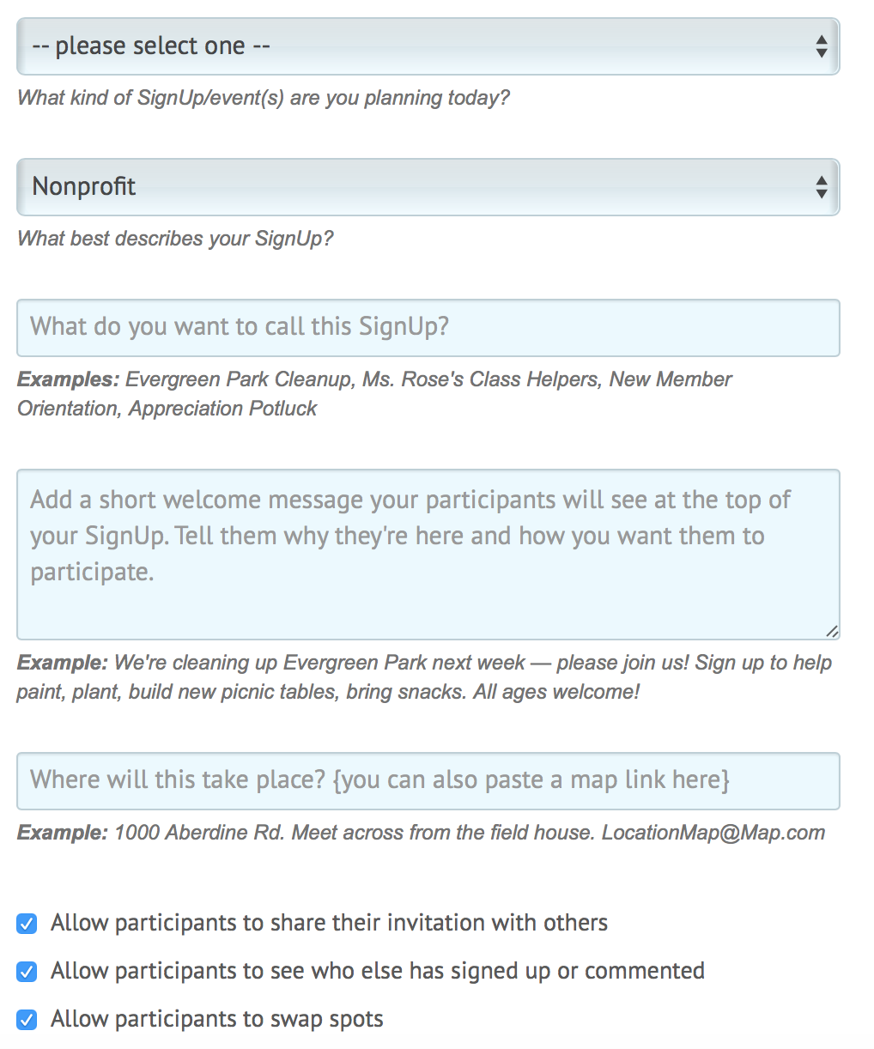
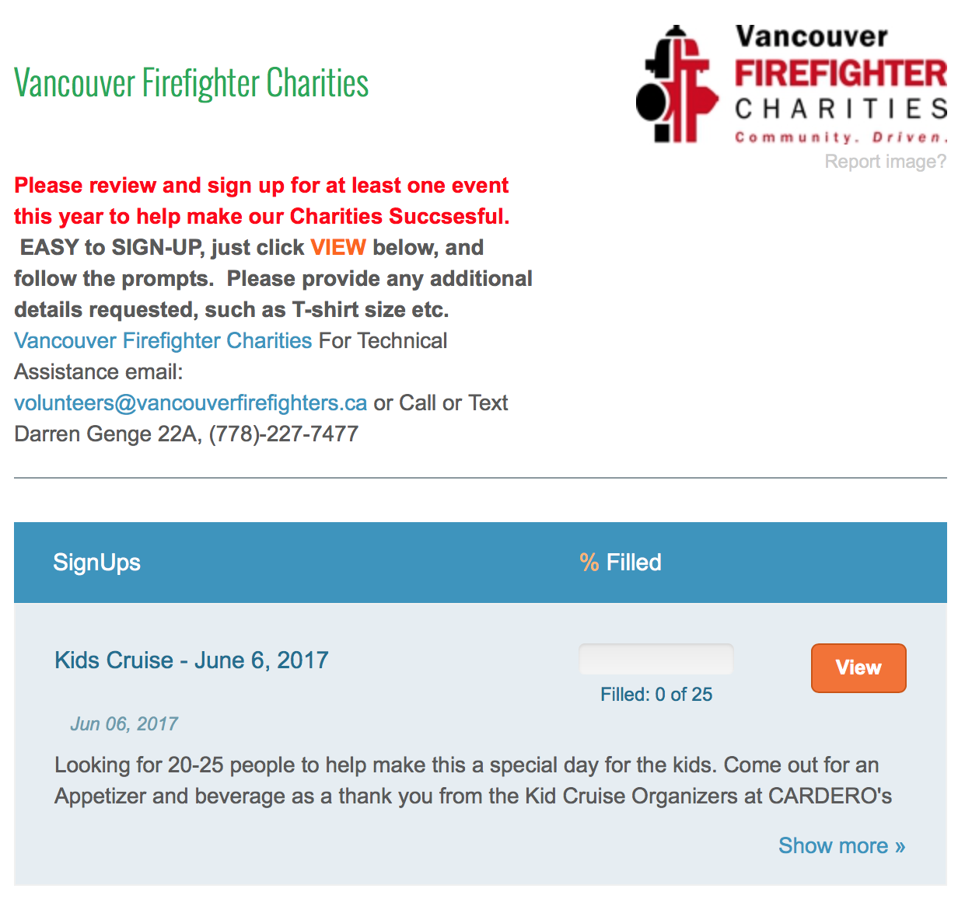
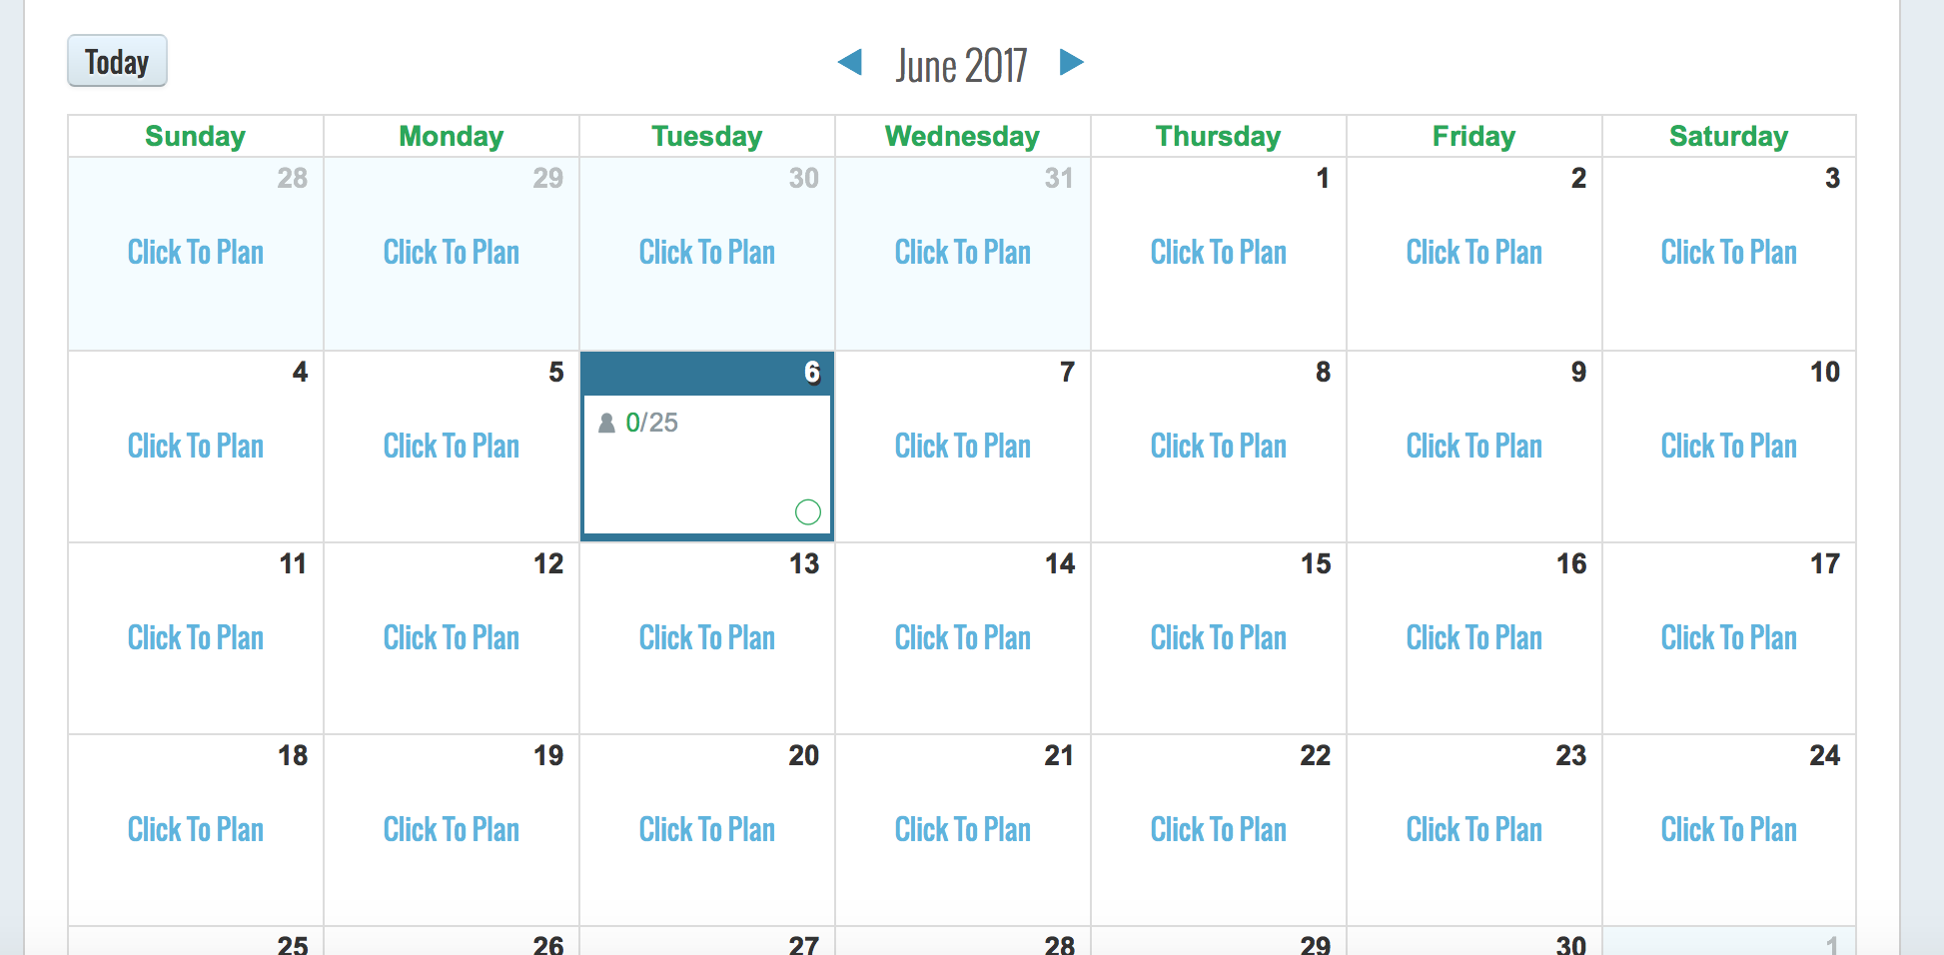
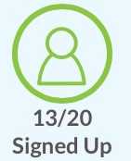
How does it work?
Notes:
Click the create new sign up to who quick sample. Also show duplicate event buttons. and show a few other buttons in this slide.
Organizers can track to see if people have followed links to see what event is about. Organizers can manually add participants, also you can create events after the event has past to track as well.
What time is it……………….5 mins max

Slide 7
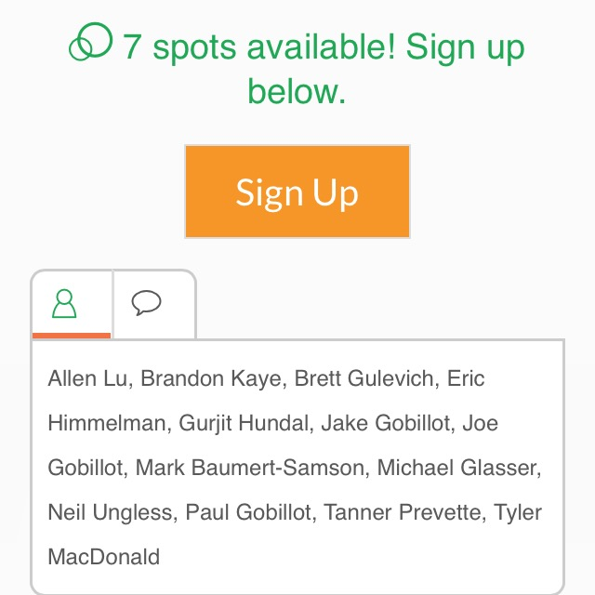
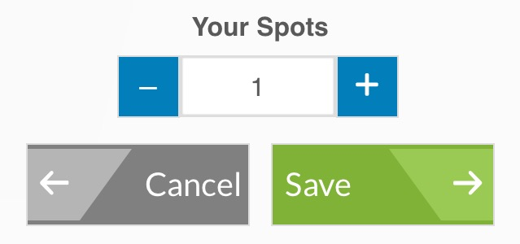
Why volunteers like it.
Sign up via Facebook posts, or unique/custom URL’s
Receive details via email
Automatic updates two days prior to event
See who's coming
Use smartphone to sign up, cancel and track hours

Slide 8
Vancouver Firefighters’ Charities tracked over 3500 hours, 60 Events, and 700 volunteers in 2016 using Signup.com

Slide 9
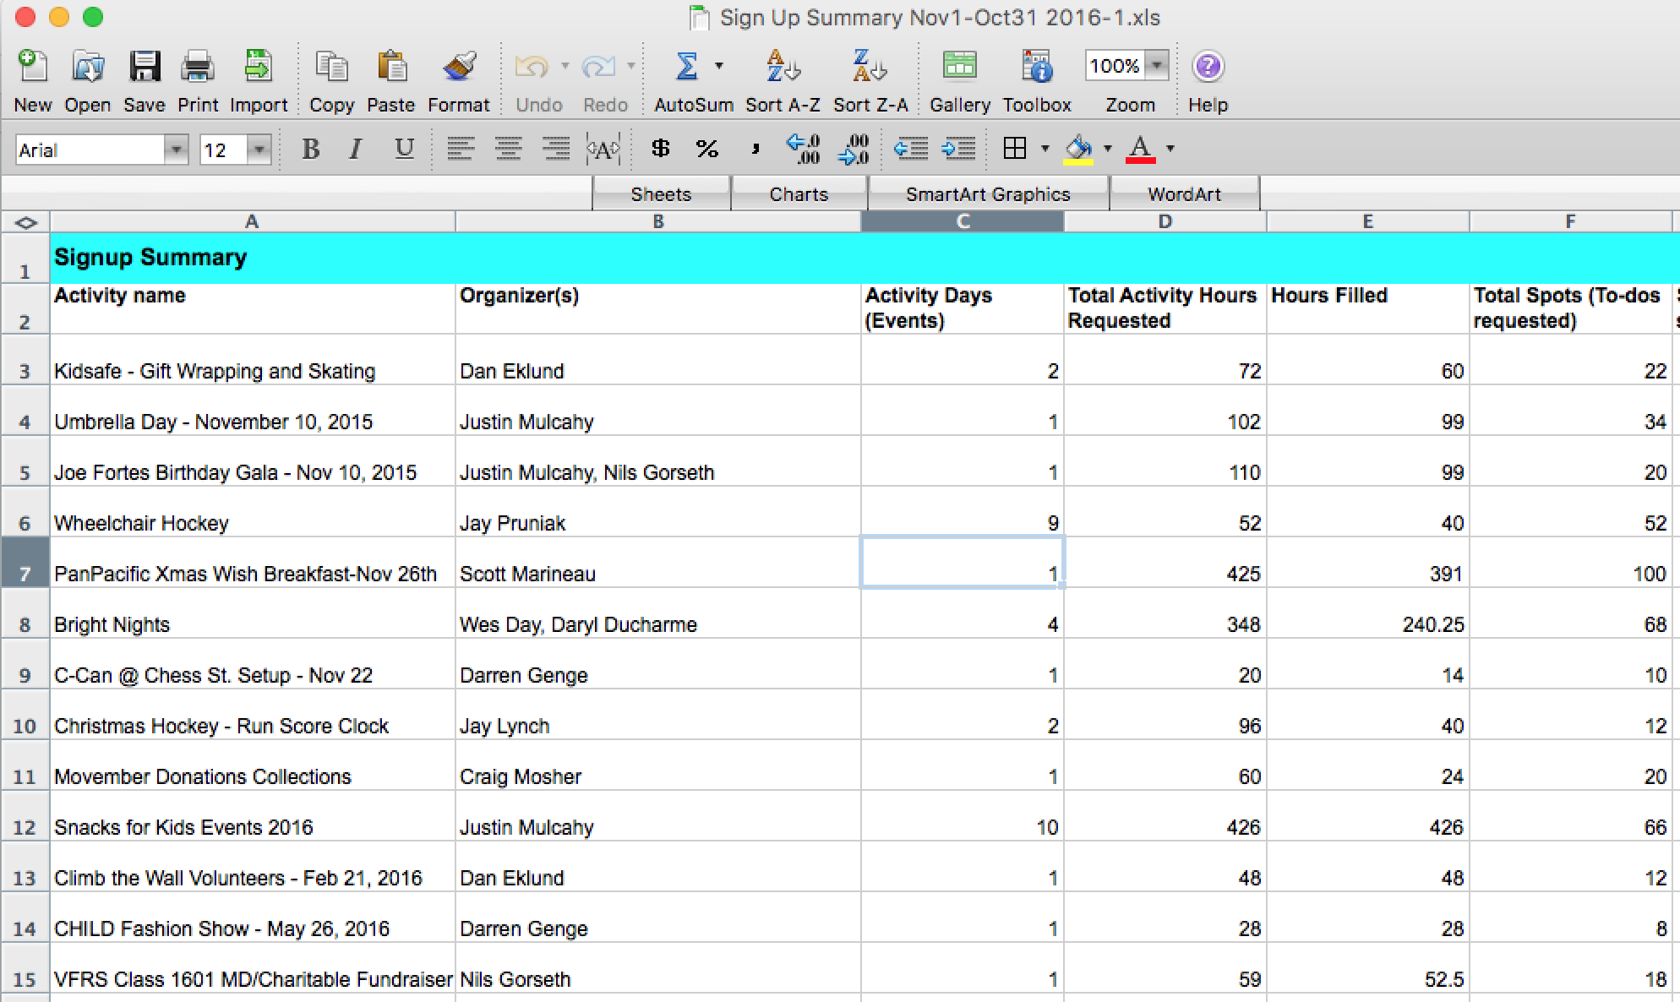
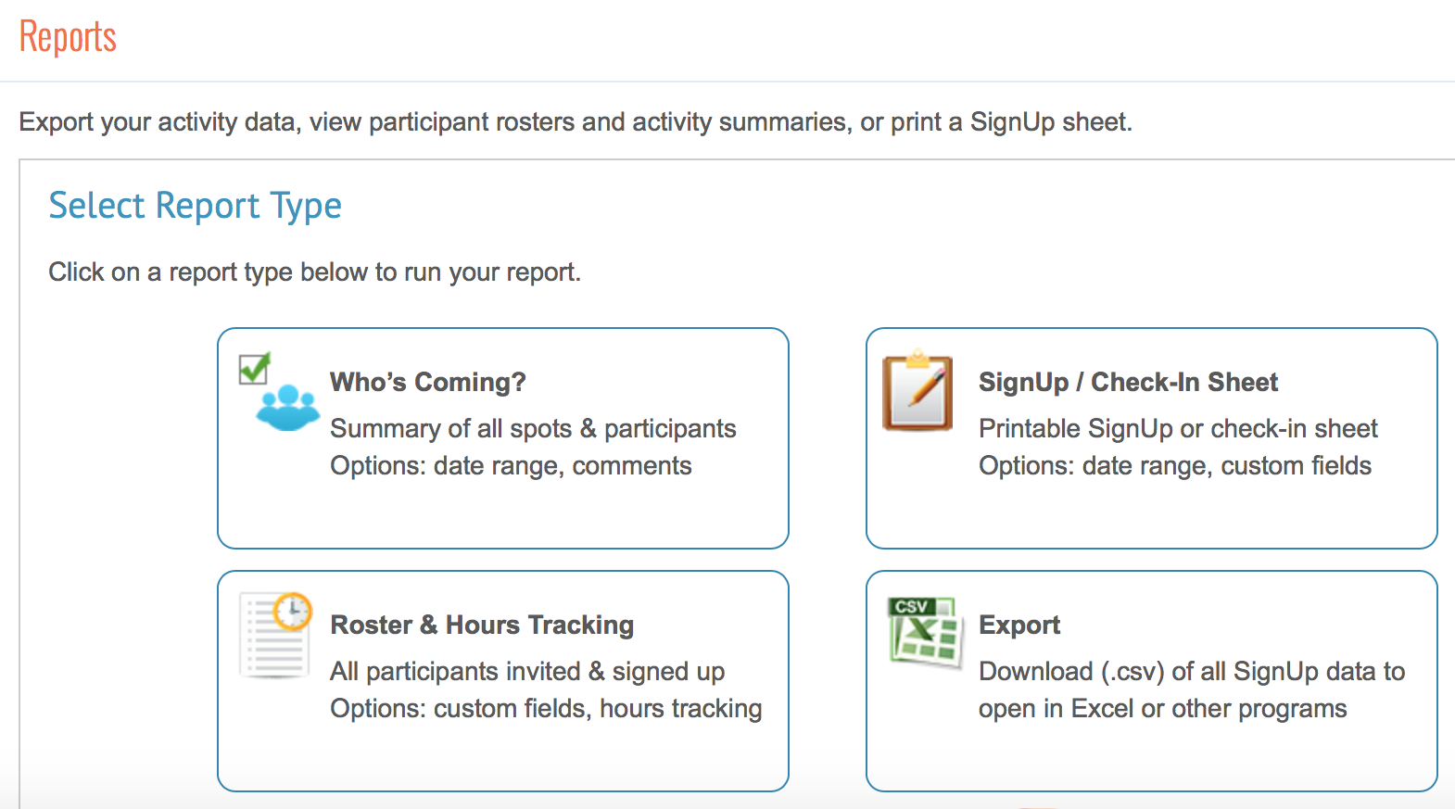
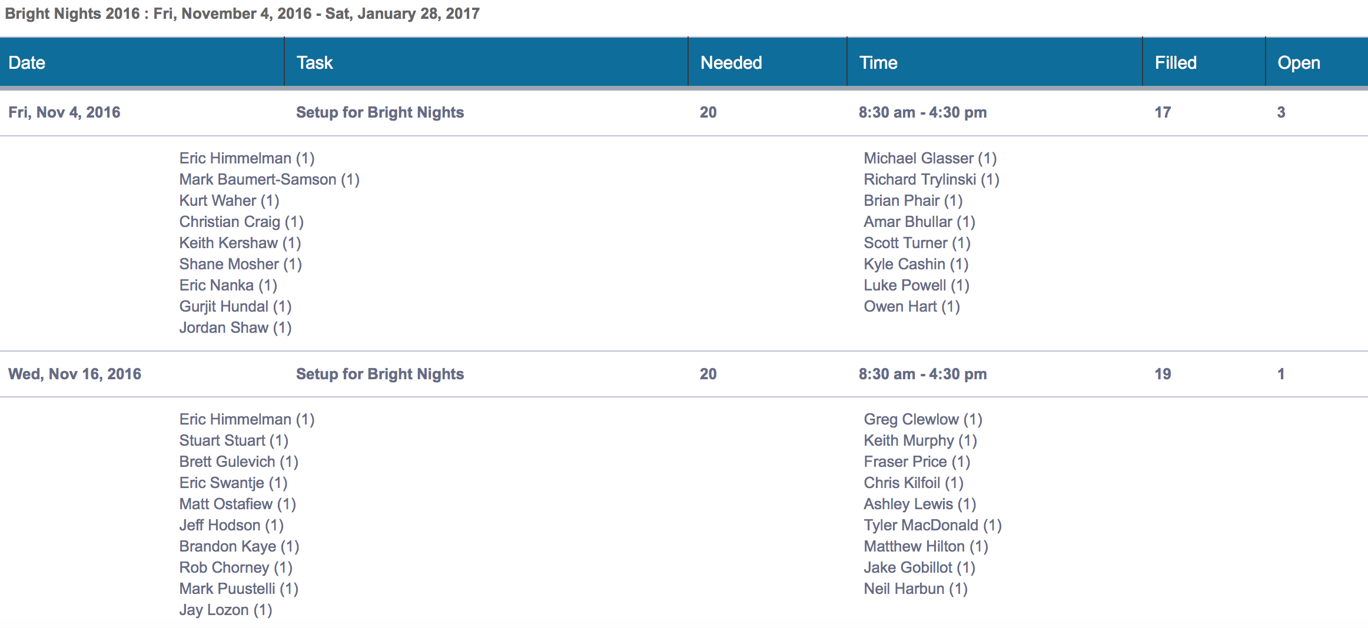
Reporting
Notes:
Variety of different reports, can report across all signups, by date etc. XLS and CSV.
Also the organizer can see who is coming, online, smart phone, or send Pdf
We produce reports at year end for the directors and union so we can acknowledge people whom have stood out with exceptional work in the year.

Slide 10
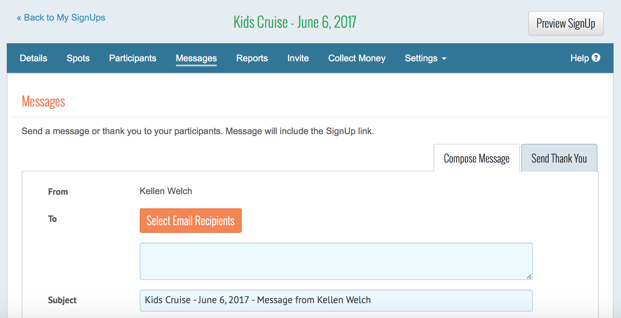
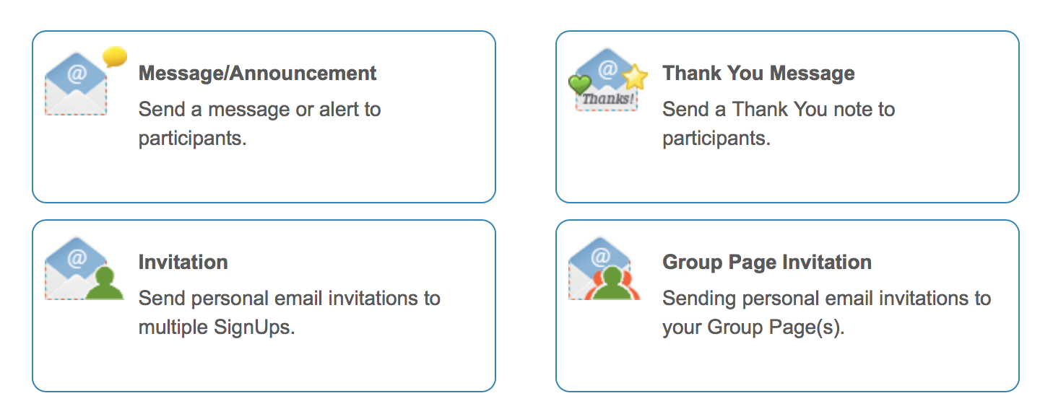
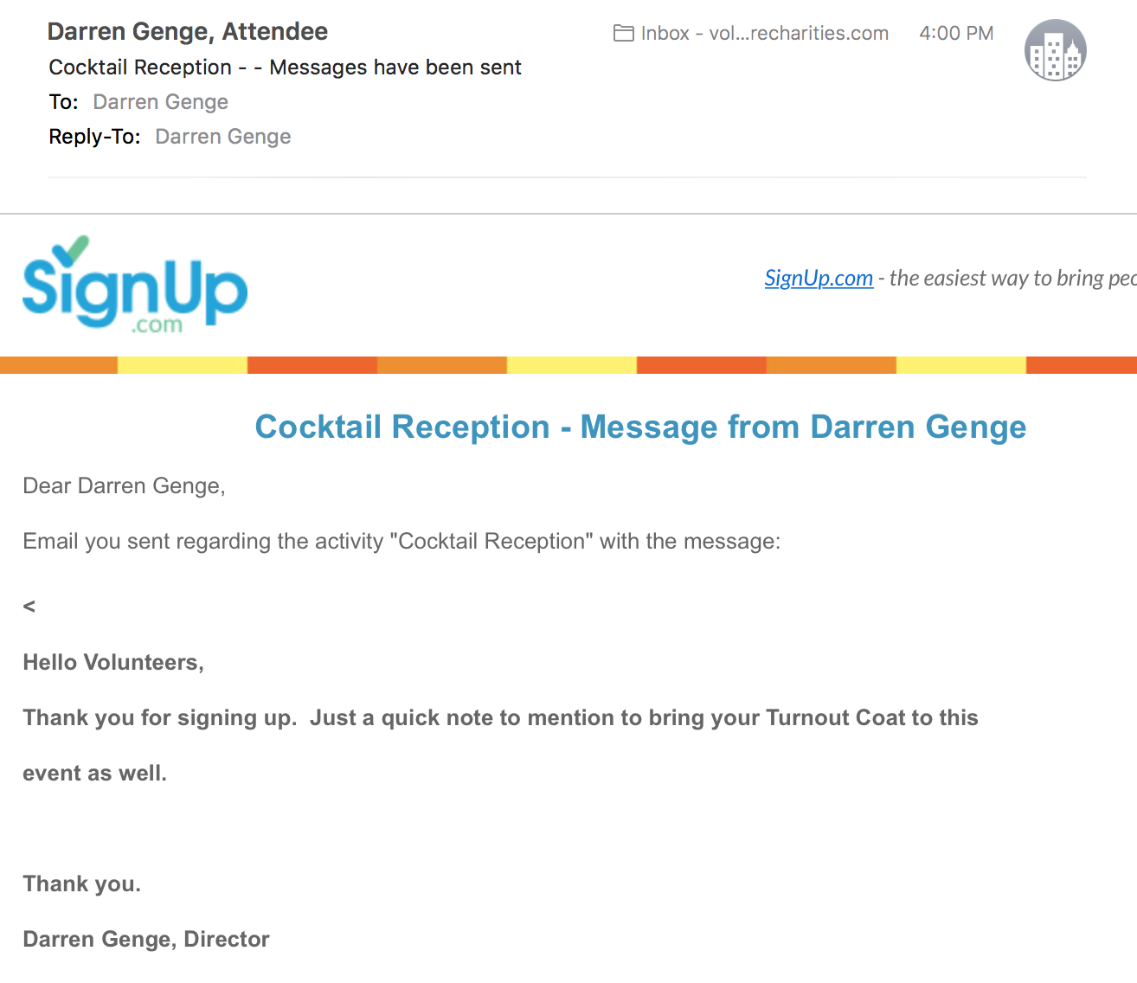
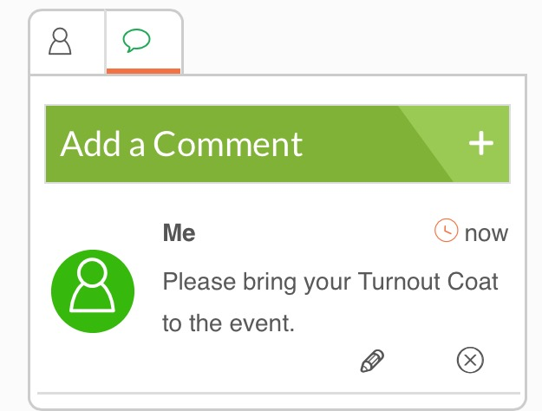
Messages
Notes:
often we have changes of times, attire, etc and you can send details out prior to event, post comments, respond to comments from participants.
These are extra messages, automatic email go out 1or 2 days prior to events and have a link to change the participants status. ie you can cancel from here, all cancelations are also sent by email to all the organizers.

Slide 11
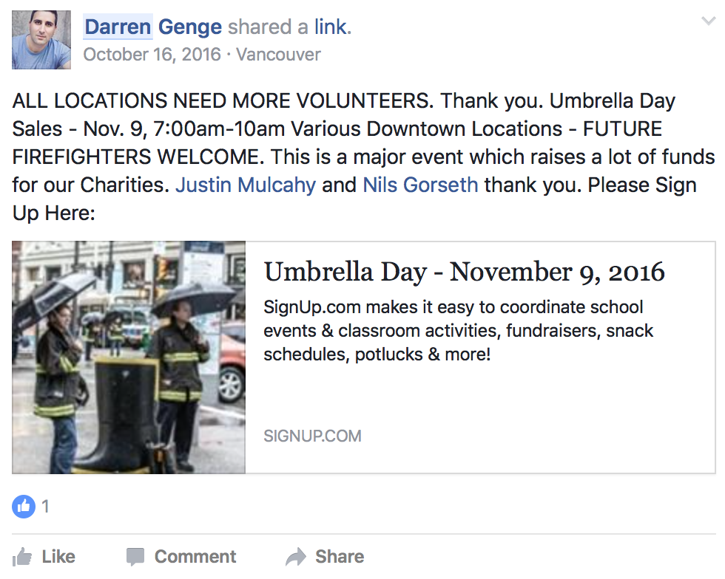
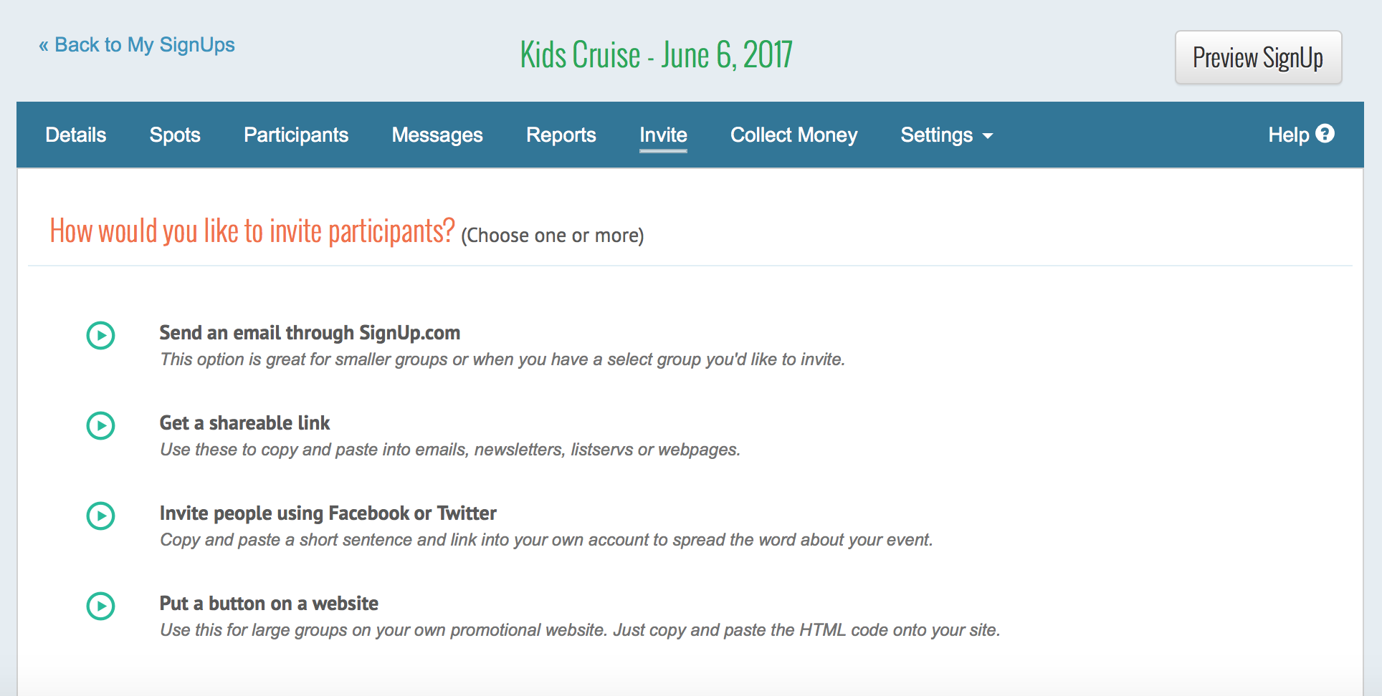
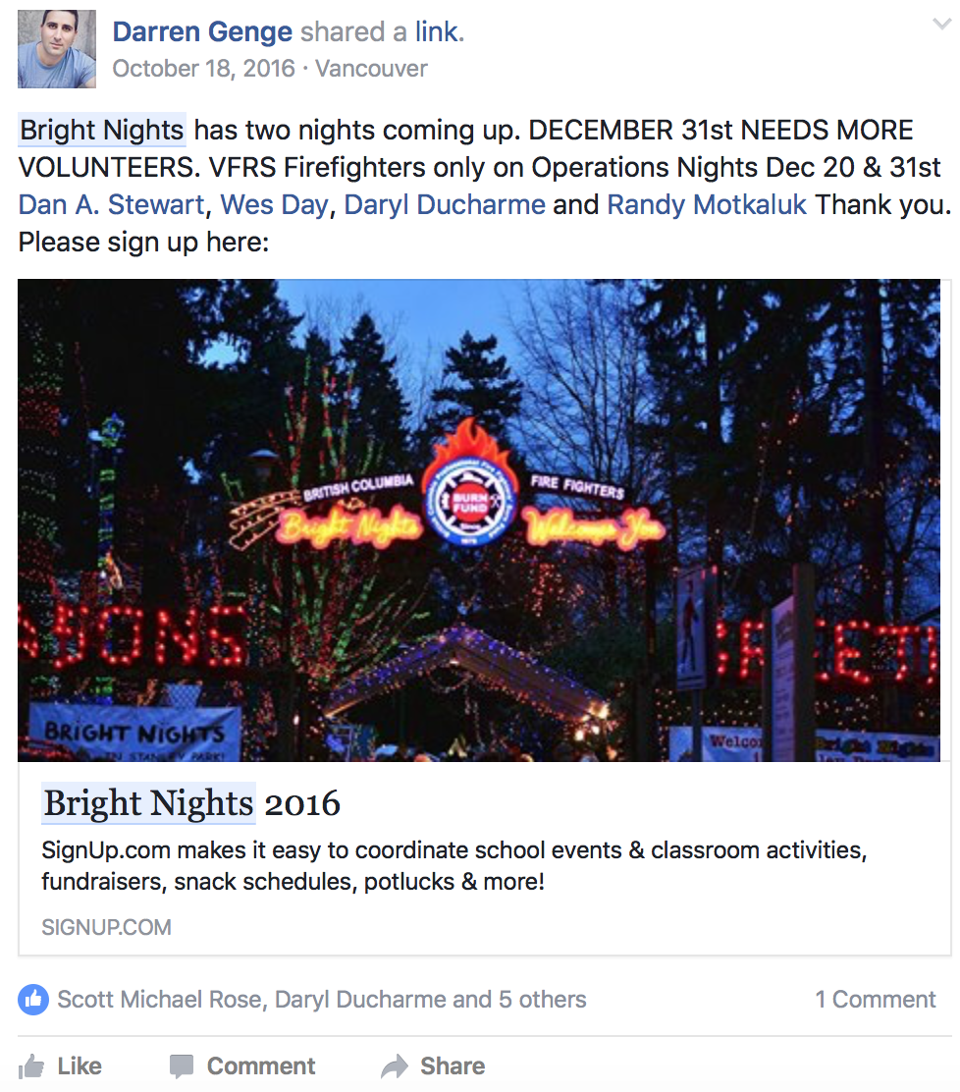
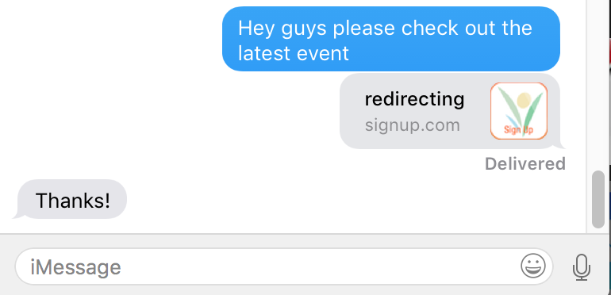
Invites
http://signup.com/go/A16xuH

Slide 12
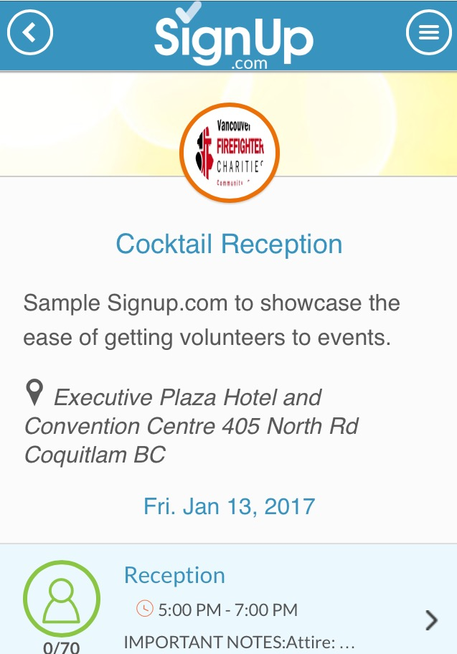
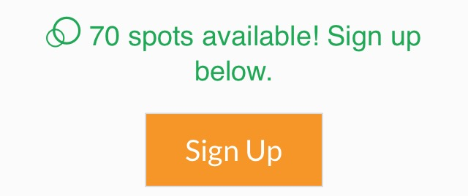
Interactive Demo
http://signup.com/go/Reception2017

Slide 13
Thank you.
info: volunteers@vanfirecharities.com

