Slide 1
Charities and Taxes
Presented by:
Andrea Knorr, CPA, CGA

Slide 2
Andrea Knorr
My name is Andrea Knorr, and I’ve been a CGA since 1997. I have worked in public practice for W. Bruce and Associates since 1994. I am now a partner in the firm which has been around since 1982.
We provide a variety of services to our clients in the following areas:
auditing of Societies, Unions, Associations and other not for profit organizations
accounting and income tax for small businesses
management and computer consulting
personal income tax services

Slide 3
Topics for Today
How to Start a Charity
Tax Receipting
Budgeting
Bookkeeping
CRA Compliance

Slide 4
How to Start a Charity
Benefits
T2050 needs to be completed and sent to the Canada Revenue Agency (CRA)
Form available on CRA website – search T2050
Guide T4063 is available (also online) to help with completing form T2050
Usually 2 to 6 months to get approval
Charity Directorate 1-800-267-2384

Slide 5
GST Registration
Charity receives 50% of all GST paid on purchases
Periodic GST reporting (semi-annually or annually)

Slide 6
Tax Receipting
“Must Haves”
“Don’ts”
When to Issue

Slide 7
Must have on Tax Receipts
“Official donation receipt for income tax purposes”
Receipt No.
Charity’s name as on file with CRA
Charity’s address
Charitable registration No.
Date or Year gift was received
Date receipt was issued if different from “received” date

Slide 8
Must have on Tax Receipts
Donor full name
Donor address
Amount of gift (FMV) – cash amount or gifts in kind (Note: for gifts a brief description & it is recommended that it be appraised if more than $1,000 value)
Amount of advantage to donor (FMV) (if applicable)
Eligible amount of gift
Location receipt issued
Authorized signature
Name and website address of the CRA

Slide 9
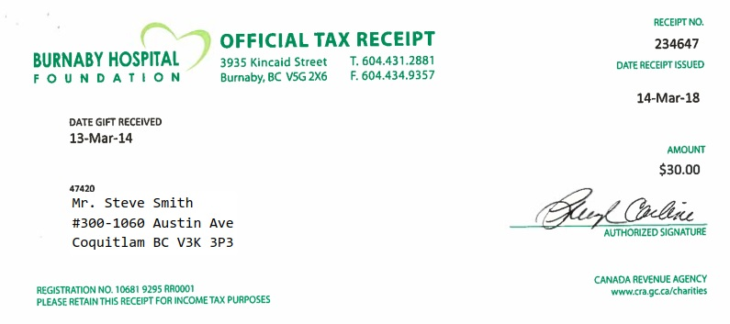
Example Tax Receipt

Slide 10
Cannot issue receipts for:
Services provided to the charity
On behalf of another organization or charity
In a name other than the name of the true donor
Donations directed to a specific individual or family
Donations to the benefit of the donor
For gift cards or certificates (ie: silent auction)

Slide 11
When to issue receipts
No time frame
According to your schedule
Before February 28 of next calendar year
Issue periodically or a single cumulative receipt

Slide 12
Electronic tax receipts
Receipt still has to contain all required info
Receipt can be reproduced by the charity
Receipting information is stored on a protected system

Slide 13
Receipts can be emailed if:
They are sent in a non-alterable format (ie: PDF)
Signed with an electronic signature
Charity must keep copy of all emailed receipts

Slide 14
Gift of Investments
Great way to get donors to give you funds where they get a tax advantage
For example:
Donor wants to give $5,000 to charity
Donor has $5,000 in stocks
Donor transfers stocks to charity, avoids tax on capital gain
Charity issues receipt for FMV of shares from Donor
Charity sells shares – no capital gain

Slide 15
Organizing Receipts
Need list of receipts issued in period
Excel
Database
Keep copies of all voided receipts
Keep a copy of issued receipts
Need to account for all receipts issued
For receipts given for gifts in kind, it is recommended to attach the backup of the FMV to the receipt the charity keeps

Slide 16
Budgeting
Why set yearly budget
Goal setting
Fundraising budgets
Program budgets

Slide 17
Fundraising Budgets
If revenues fall below target
React and try to increase revenues
Cut budget on expenses
If expenses skyrocket
Cut expenses
Increase revenues
Goal is to achieve a profit on all your fundraisers that makes it worth while for the charity

Slide 18
Program Budgets
How much to budget for a particular program
Monitoring actual vs budgeted
New programs, reduction, cancellation

Slide 19
Bookkeeping
Charity must keep adequate records for CRA to verify revenue and expenses
Important to monitor revenues & expenses within specific categories

Slide 20
Specific categories example:
Revenues
Receipted vs non-receipted donations
Receipted amounts must balance to what was given
Fundraising
Sale of goods & services
Investment income
Gaming

Slide 21
Gaming Funds
Raffle, 50/50 draw, etc.
Grant
Forms to fill out for license or annual grant
Specific rules where you have to file within a set number of days after an event
Still have to file an annual gaming return based on cash basis

Slide 22
Specific categories example (cont.)
Expenses
Fundraising expenses
Management and administrative expenses
Charitable activities
Qualified donees

Slide 23
CRA Compliance
Produce financial statements
Internal and external audits
Recommend external audit or review engagement
Internal controls
Don’t want unauthorized access to data and donation receipts
Don’t want funds raised to be misappropriated
Disbursement Quota
Charity Tax Return – T3010
6 months after charity year-end
Can lose charitable status if not done
CRA Audits (periodically)
Keep Charity Directorate up to date
i) Officer/director information
Ii) Program changes need approval

Slide 24
Disbursement Quota
Minimum amount a registered charity is required to spend each year on its own charitable activities or on gifts to qualified donees
Changed in 2010 from 80% of the amounts for which official tax receipts were issued in the prior fiscal year
The calculation is now based on the value of a charity’s property not used for charitable activities or administration
3.5% of the average value of that property

Slide 25
T3010 Charity Return
Goes onto CRA website for anyone to see
They will see:
Purpose of organization
Are there employees of the organization and how much were they paid
Political activities
Activities outside of Canada
Financial Statement information
What was receipted for cash gifts and gifts in kind
What was spent on charitable programs, administration, fundraising or donations to other charities

Slide 26
Q & A
Please call or email me if you have any additional questions.
Andrea Knorr, CPA, CGA
Andrea@brucecpa.com
604-931-3347

Slide 27
LINKS
T2050 Form:
http://www.cra-arc.gc.ca/E/pbg/tf/t2050/t2050-16e.pdf
T4063 Form:
http://www.cra-arc.gc.ca/E/pbg/tf/t2050/t2050-16e.pdf
Charity Listing:
http://www.cra-arc.gc.ca/chrts-gvng/lstngs/menu-eng.html
Contact Charity Directorate:
http://www.cra-arc.gc.ca/chrts-gvng/chrts/cntct/cntct-eng.html

